Slide 1
Haptic Fitness CSED404 Final Presentation
Team TCPs / Member Chan-ki Hwang & Taeyeon Kim

Slide 2


Vibration feedback to user’s action
Real-time
No delay between vibratory feedbacks
Directive
set proper Vibration patterns according to range
Dynamic feedback on specific event, interval…
Attach on the body to fetch user’s position

Slide 3
Code Implementation
MVVM (Model – View – ViewModel)
Data Binding
Update Value
ViewModel
Model
Transfer Action
View
Request Data

Slide 4
Code Implementation
CreateView
Sensor Handling
Looper
Vibration Generate
Looper
Sensor Init
Vibrator Init
onSensorChanged
post
post
Array<> .forEach
VibratorManager. vibrate
Thread Init
Array<(Int) -> CombinedVibration?>
pattern
DestroyView

Slide 5
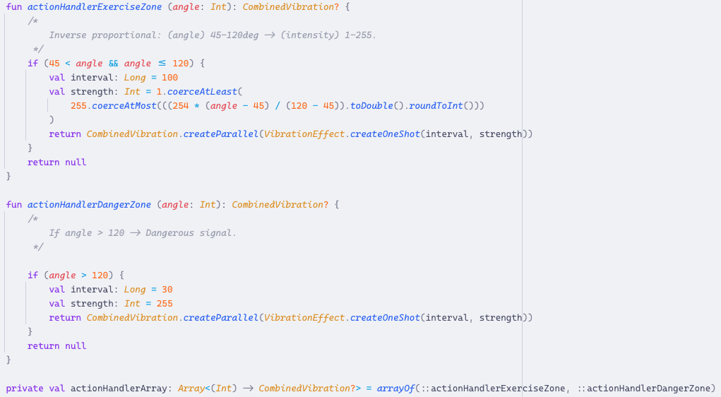
Code Implementation
Modularity!

Slide 6



Examples
REJECT
“SAFE”
“MORE”
REJECT
“MORE”
“SAFE”
Start/Stop Exercise
Start/Stop Exercise
REJECT
“DANGER”
REJECT
“DANGER”

Slide 7

Examples
REJECT
“SAFE”
“MORE”
REJECT
“DANGER”
Start/Stop Exercise

Slide 8
So… Is that ALL?

Slide 9

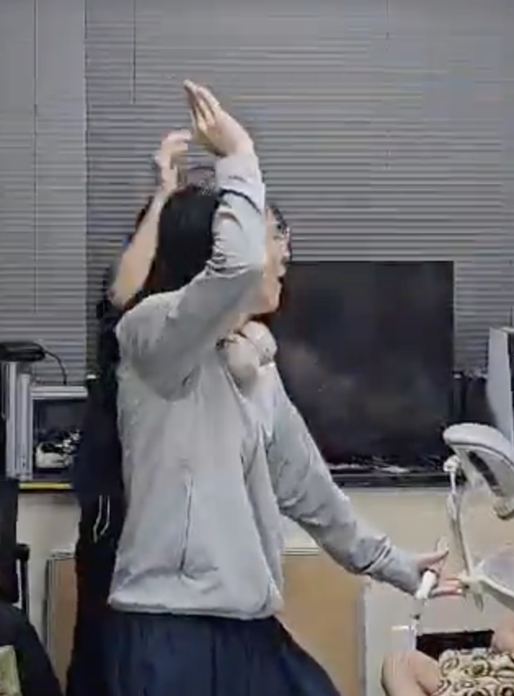

Rhythm Fitness?
APTIC
WE DID IT!

Slide 10

Rhythm Fitness Implementation
But, How to detect
PROPER movement?
+y
+x
THRESHOLD
0
+z
THRESHOLD
←→↑↓⨀⨂

Slide 11




Rhythm Fitness Detection
Lightweight
Reliable
Compatible to modern rhythm games
t
t
Δt
0
0
0

Slide 12
Rhythm Fitness Detection?
Lightweight X
Reliable X
Compatible to modern rhythm games
pointer
queue<Double>(WINDOW_SIZE)
0
Feedback
SLOW
FAST
Judgement Algorithm
PERFECT

Slide 13
Rhythm Fitness Detection?
Lightweight OK
Reliable OK
Compatible to modern rhythm games
queue<Double>(WINDOW_SIZE)
Double avg = avg * T + sensor * (1–T)
avg
0
Feedback
Judgement Algorithm
PERFECT

Slide 14

Rhythm Fitness Demonstration!
Remix 10, From Rhythm Heaven Fever (Wii)
🤣 Well-known ‘meme’ song
🕹️ Easy to control
Wii remote has only [A] and [B]
🤸 Active exercise
I have danced along this song – very tough :D.

Slide 15
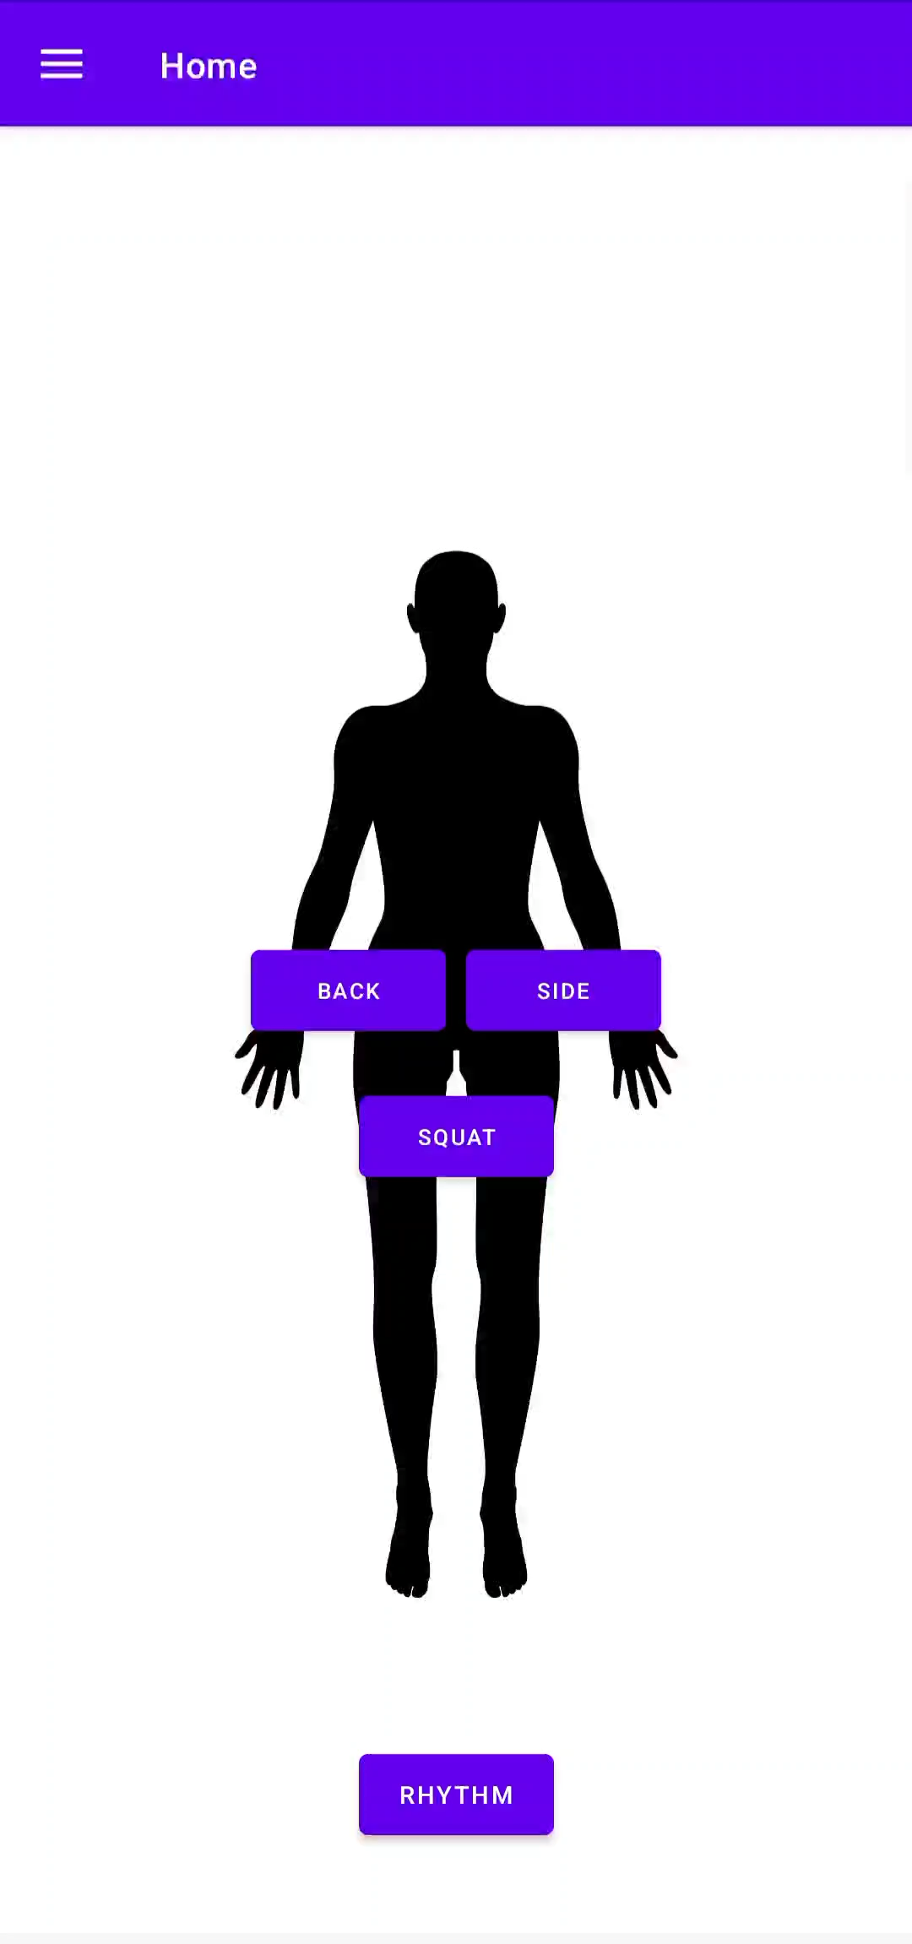
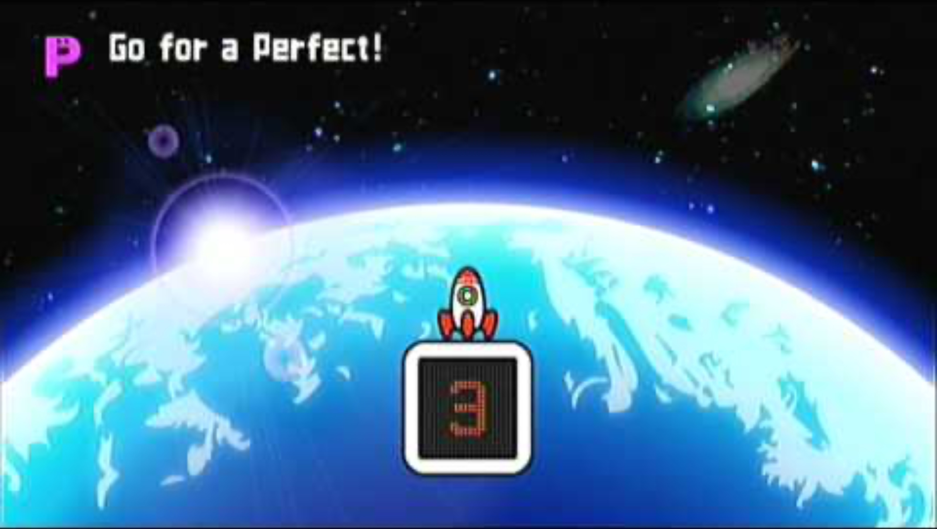

Rhythm Fitness Demonstration!
Original
Wii Gameplay Screen
PLAYED BY
Our
Implementation

Slide 16
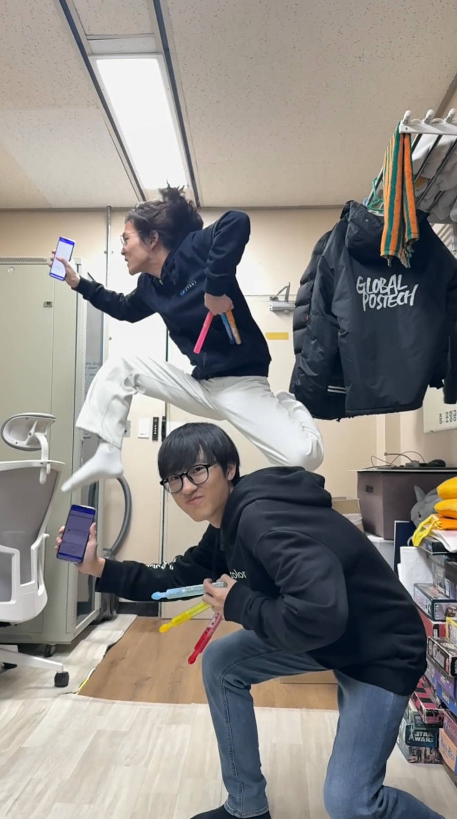
Thanks for Listening
… and Have Fun with Exercise!

